Slide 1

Mechatronics
Midterm Presentation
Group G: Bobs the Builders
Eric Newhall
Guillermo Cidre
Michael O’Connor
Christian Heaney-Secord
1

Slide 2
Design Requirements
20 parts must be processed in < 5 minutes.
Flux dab must be centered on the part-top centroid and cover ¼ to ⅓ of the part-top’s surface area.
Handle at least two different part sizes.
Machine fits within 2’x2’x2’
Two wires must be placed side by side in the flux dab.
< 5% of wires detached or wrongly positioned.
Parts will be deposited on a flat output tray in 4 rows of 5 parts each, with the part-tops facing up.
2

Slide 3
Design Concept
Part Separator
Constrain hopper outlet to only allow for 4 orientations
Vision Processing
Detect part orientation
Part Placer
Move part from camera to tray
Moves only in x-axis
Tray Positioner
Move in y-axis to facilitate part placer and flux and wire dispenser
Flux and Wire Dispenser
Extrude flux onto the top surface of each part
Cut and place wires on top of the flux on each part
Moves only in x-axis
3

Slide 4
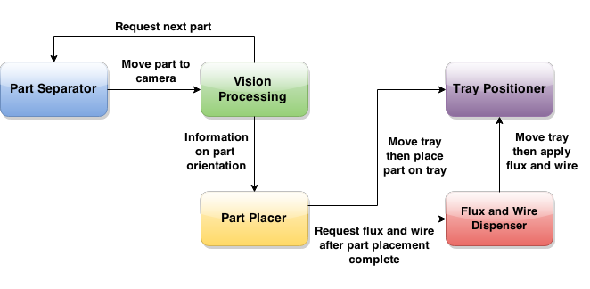
Functional Architecture
4

Slide 5
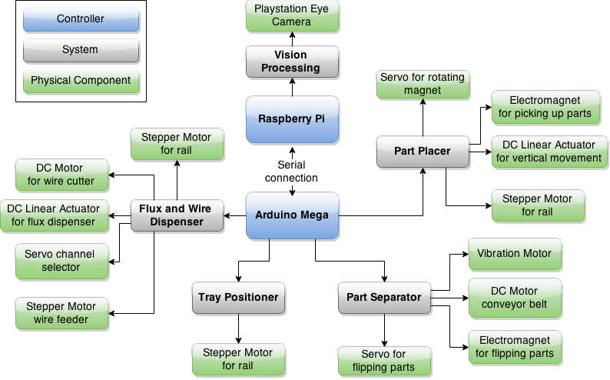
Cyberphysical Architecture
5

Slide 6
System Description
Part Orientation
View part profile with Playstation Eye
Flip parts using a servo and electromagnet
Tray Positioning
Actuate tray mounted on rail system using a stepper motor
Part Placement
Use electromagnet to grab part
Raise and lower part using a vertical rack and pinion
Have tray position itself underneath part
Flux Extrusion / Wire Placement
Use a linear actuator to push flux out of a plastic tube
Use an augmented bolt cutter to cut wires
Feed wire and flux through plastic tubing
Have tray position parts underneath subsystem outlet
6

Slide 7
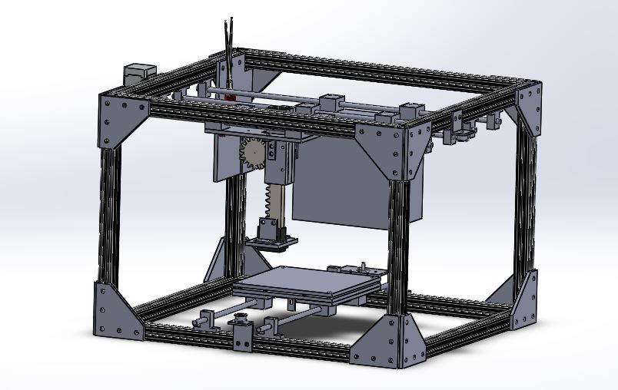
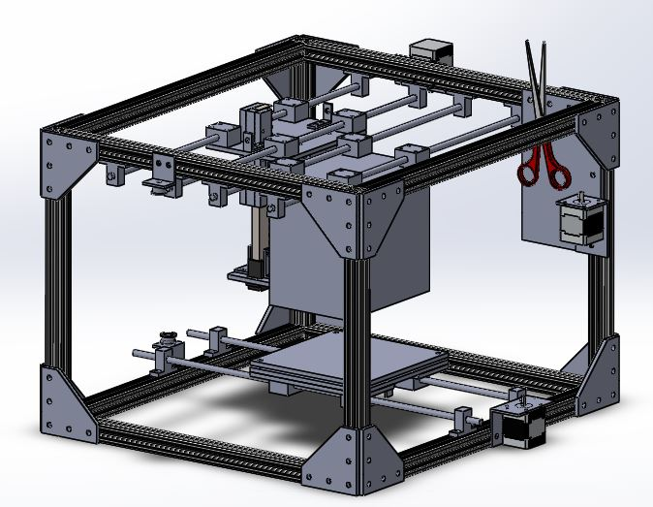
System Description
Vision Processing
Compare captured image to 4 template images
Calculate differences
Shift captured image in direction of decreasing error until a minimum error is found (for each of the 4 cases)
The case with the lowest minimum error is the orientation
CAD Models
7

Slide 8
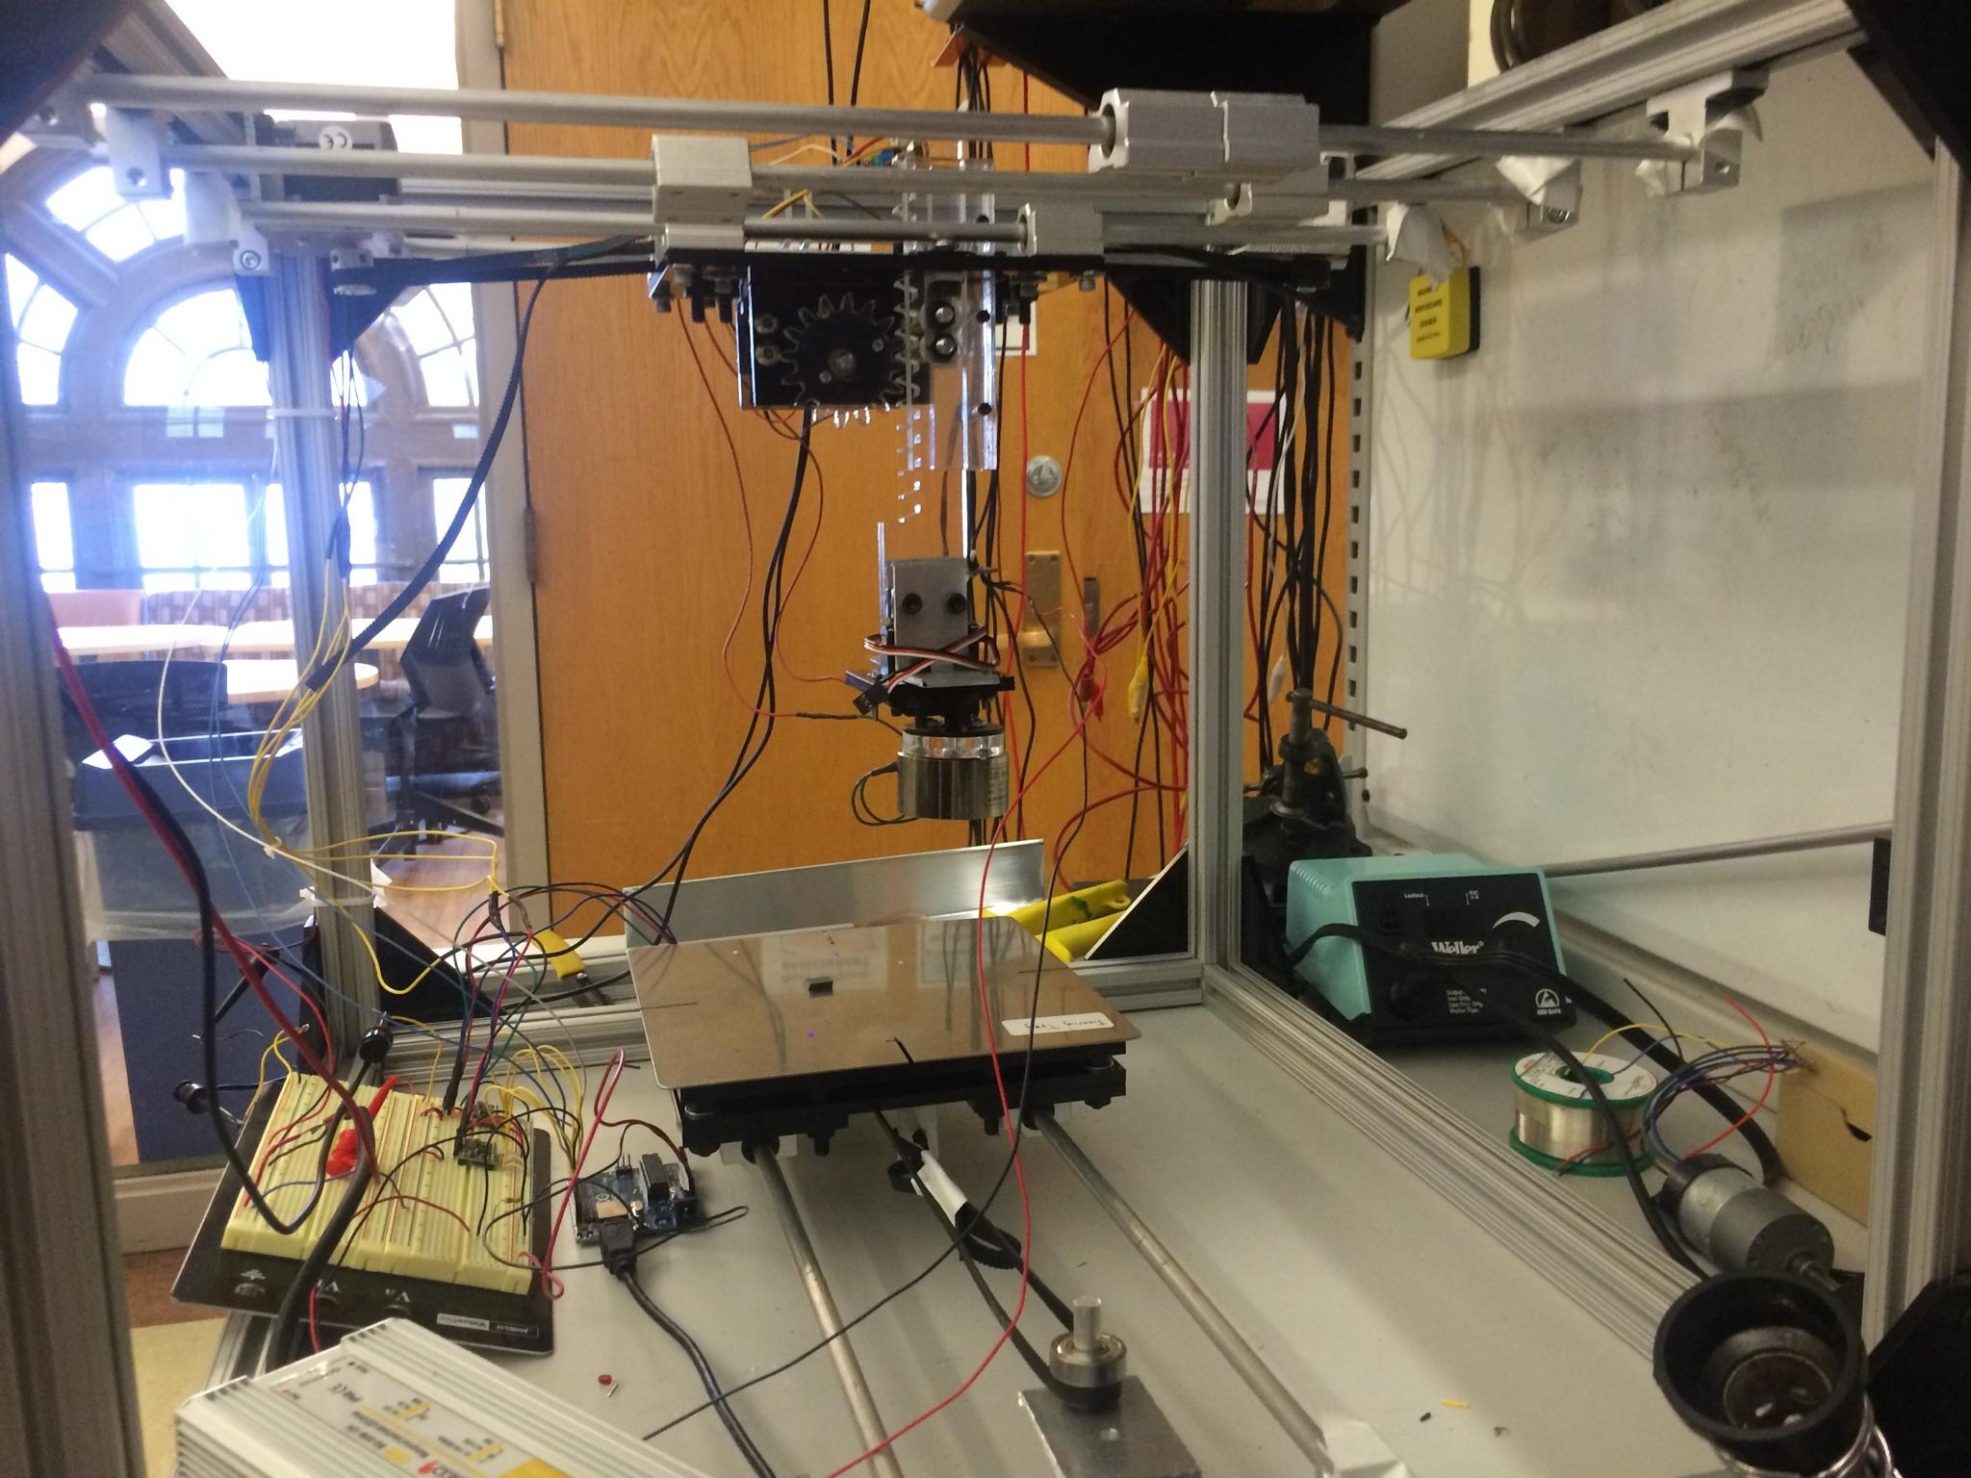
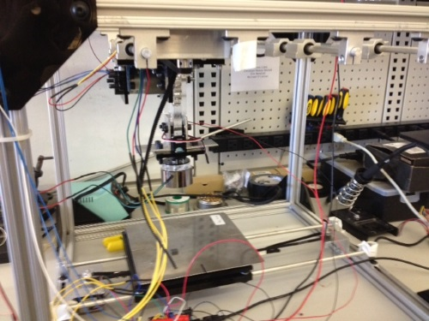
Current System Status
Completed
Frame
Rails for tray and part placer
Electromagnet, servo, and linear actuator for part placer
In progress
Flux Extrusion
Wire Cutting
Rail for flux and wire dispenser
Vision processing software
Hopper
Not yet started
Conveyor belt
Part flipper
8

Slide 9
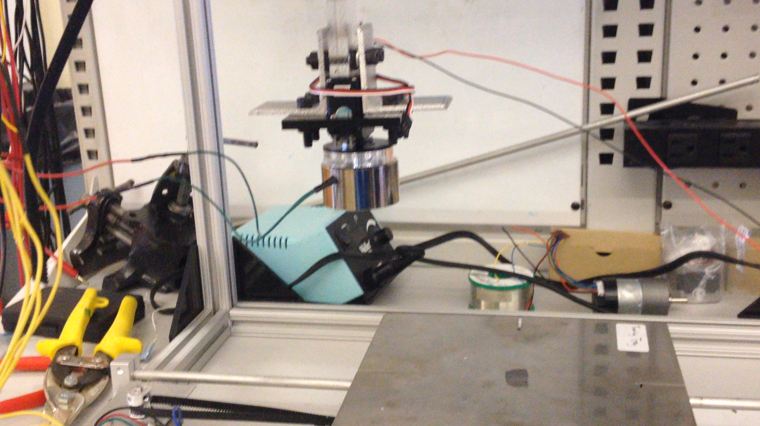
Current System Demo (video)
9

Slide 10
Schedule
March 11 | Flux extrusion and wire cutting
March 18 | Mount assembly for flux and wire placement | System Demo #3
March 25 | Develop hopper configuration | System Demo #4
April 1 | Integrate vision processing and conveyor belt into system | System Demo #5
April 8 | Implement part reorienter | System Demo #6
April 15 | Subsystem cleanup | System Demo #7
April 22 | Calibrate system | Final System Demo
April 29 | Fine tune / speed up assembly | Final System Demo encore
May 4 | Prepare for public presentation | Public Presentation
May 8 | Finish final report | Final Report
May 11 | Add material to website and clean up lab station | Website Check
10

Slide 11
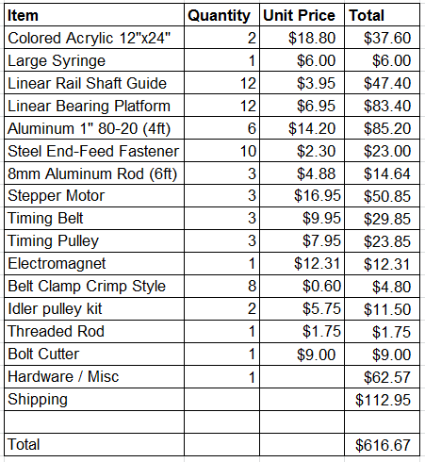
Budget
2

Slide 12
Risk Management
System time constraints (5 minute total)
Parts exiting hopper
Increase outlet size and perform additional reorientation later
Vision processing Time
Adjust algorithm or outsource processing to a laptop
Budget
Use cheap / common materials
Accuracy
Use microstepping on stepper motors
Part sensing
Handling two different size parts
Integrate a few swappable pieces
12

